Slide 1
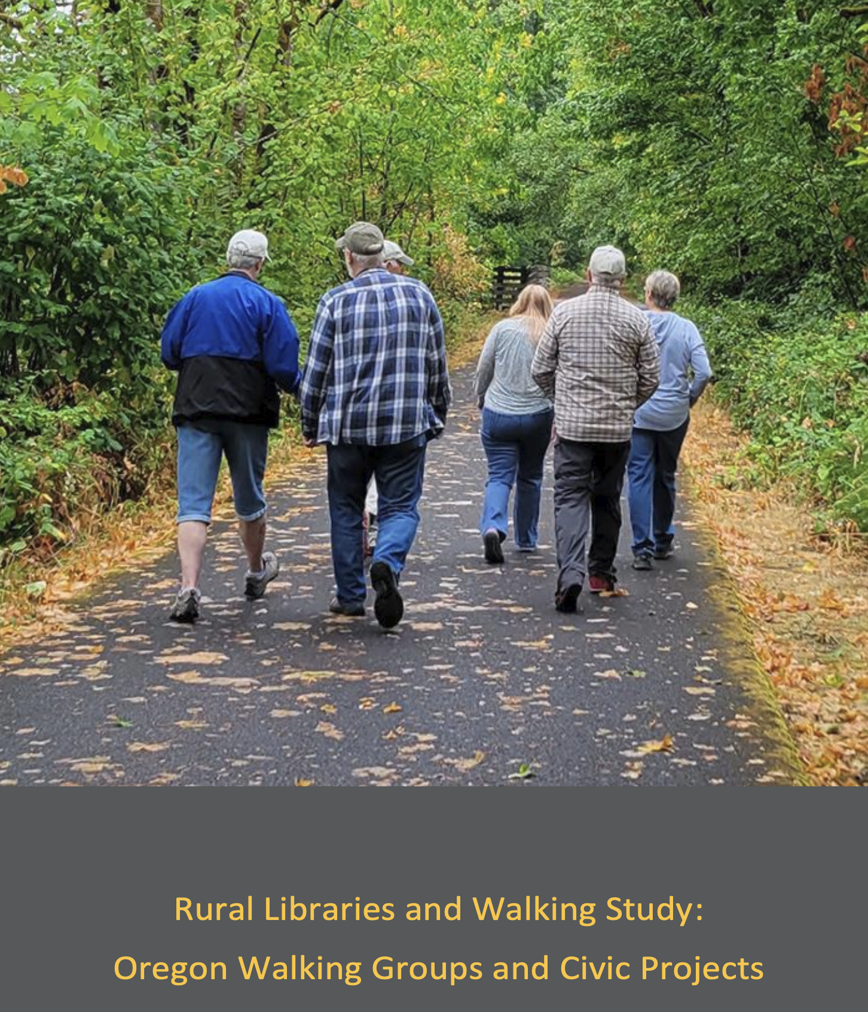
Walking Together,
Reaching Beyond the Library
[Add Photo:
Booklet cover — walkers
on tree-lined path]
How Library-Based Walking Groups
Build Community Connections
Noah Lenstra, PhD
University of North Carolina at Greensboro
lenstra@uncg.edu
ABOS Webinar | October 2026
Full report at: https://letsmovelibraries.org/wp-content/uploads/2026/01/FINALRural-Libraries-and-Walking-Study-Booklet.pdf
Notes:
Welcome everyone. Today I will share practical strategies and lessons learned from a two-year project in which 18 rural Oregon libraries hosted weekly walking groups. You will leave with actionable ideas and a free toolkit for starting a walking group at your own library.

Slide 2
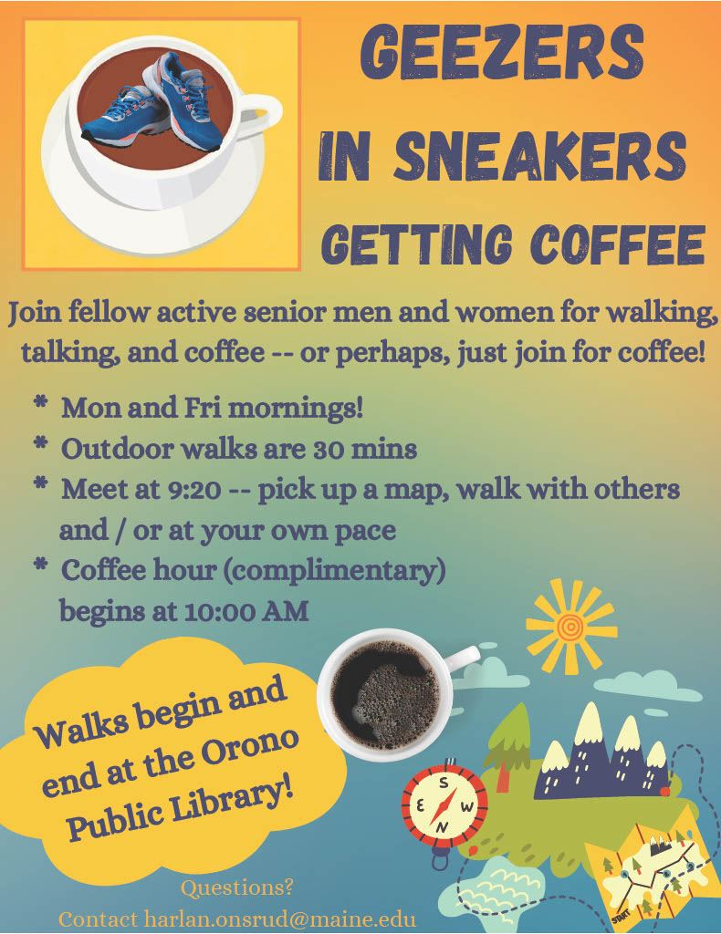
Why Walking Groups?
Walking is the most accessible form of physical activity [and can be made even more accessible through route planning]
No special equipment, training, or facilities required
Reduces risk of heart disease, diabetes, and depression
Group walking adds social connection and accountability
Builds community bonds while improving health
Suitable for all ages and fitness levels
[Add Photo:
Booklet p.25 — Sole Mates
at Shore Acres State Park]
Notes:
Walking is uniquely accessible. Unlike gym programs or team sports, anyone can participate. Group walking adds the social dimension that makes people come back week after week. The research is clear: regular walking reduces chronic disease risk and improves mental health.

Slide 3
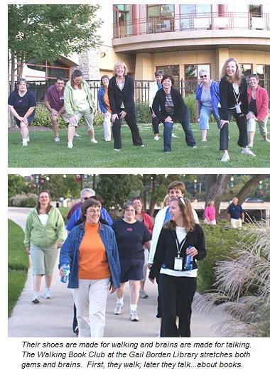
Libraries Beyond Their Walls
Libraries are trusted, free, and accessible community spaces
More than 17,000 public libraries across the U.S.
Increasingly recognized as partners in community health
Library programming can extend beyond physical walls
Natural hosts for community wellness programs
Outreach connects libraries to new community members and partners
Notes:
This connects to the ABOS conference theme of "Beyond the Stacks to Community Connections." Libraries are already trusted spaces. Walking groups are a natural extension of that trust into health and well-being, reaching people who may not otherwise use the library.

Slide 4
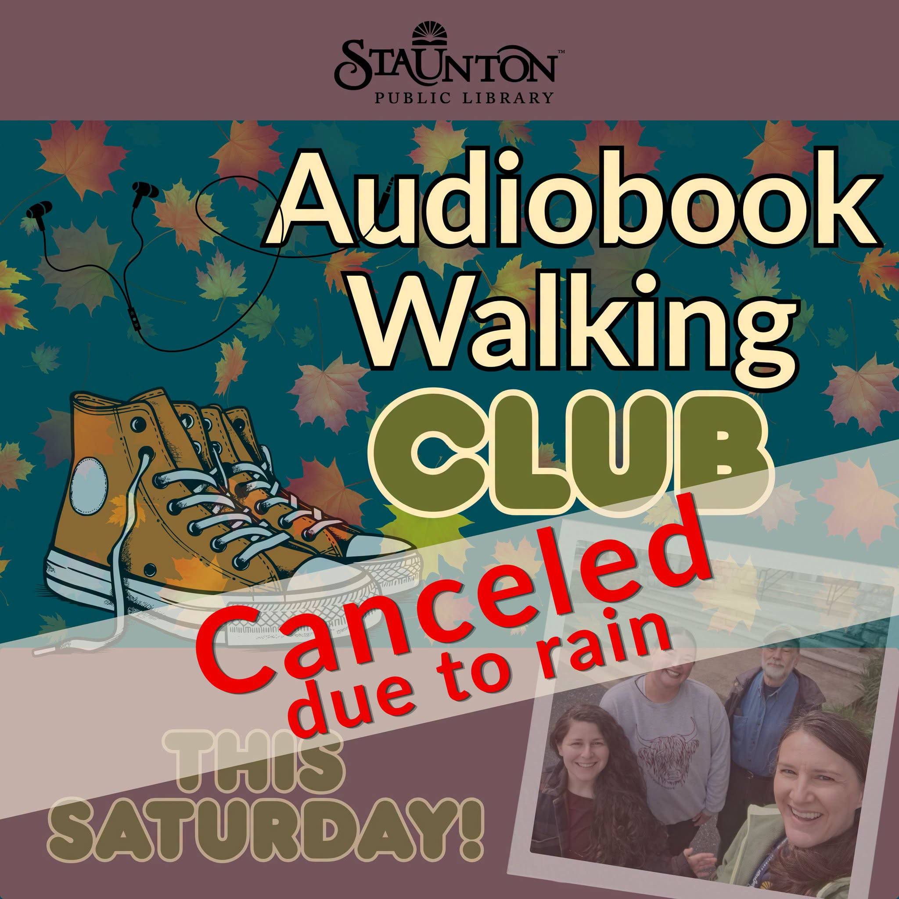
Here be dragons! What to watch out for
Rome wasn’t built in a day – your first attempt may strike out
Finding when to start and how to start are tricky issues with no clear answers
Weather is unpredictable
Not everyone walks at the same pace
Walking and talking does not work for everyone
Let’s talk! What is YOUR experience hosting, leading, or supporting walking groups? What challenges have you encountered?
Notes:
This connects to the ABOS conference theme of "Beyond the Stacks to Community Connections." Libraries are already trusted spaces. Walking groups are a natural extension of that trust into health and well-being, reaching people who may not otherwise use the library.

Slide 5
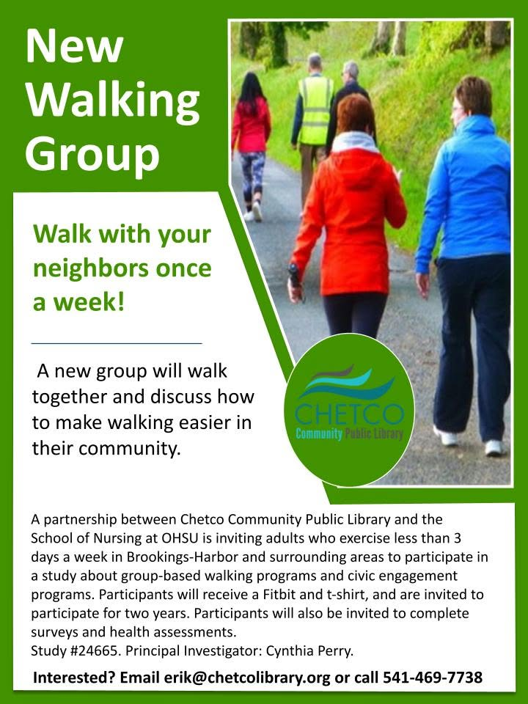
The Oregon Library Walking Project
National Institutes of Health-funded research project (May 2023 – May 2025)
18 rural Oregon libraries participated
Weekly walking groups over two years
Built on the Step It Up! model (OHSU School of Nursing)
Partnership: OHSU + University of North Carolina at Greensboro + Oregon public libraries
[Add Photo:
Booklet p.5 — Oregon
map of 18 library sites]
Research Team
Rebecca Seguin-Fowler, PhD | Noah Lenstra, PhD
Jessica Currier, PhD | Nate Dieckmann, PhD
Jay Maddock, PhD | Elena Andreyeva, PhD
Heather Franklin, MPH | Jim Winkle, MPH
Notes:
Frame this as a practitioner story, not a research presentation. Emphasize that while this was a research project, the practical lessons are what matter for this audience. The research validated what works so you can apply it confidently.

Slide 6
Two Program Models
Step It Up!
Change Club Step It Up!
9 libraries
9 libraries
Weekly 60-minute group walks
45 min walking + 10 min check-in + 5 min stretching
Group t-shirts and Fitbits
Focus: physical activity and social connection
Weekly 90-minute meetings
60 min walking + 30 min civic engagement
24-week curriculum for community change
$5,000 small grants for community projects
Notes:
Two models were tested. Both were effective for building social connections and increasing physical activity. The Change Club model added a civic engagement component that produced remarkable community outcomes. Both models are adaptable to your library.

Slide 7
Getting Started: 9 Implementation Steps
1. Build Community Partners
2. Select and Map Walking Routes
3. Publicize Your Program
4. Recruit Participants
5. Organize a Kick-Off Event
6. Lead Weekly Walking Groups
7. Build Social Support
8. Maintain Participant Interest
Identify and Train Peer Leaders
Hand it off to the community or continue to lead it (your choice!)
Based on the Step It Up! Program Implementation Toolkit: https://www.ohsu.edu/sites/default/files/2026-02/step-it-up-toolkit-accessible.pdf
Notes:
These 9 steps come from the toolkit that was developed and tested with the Oregon libraries. We will walk through the key steps in more detail. The toolkit is freely available and covers each step in depth.

Slide 8
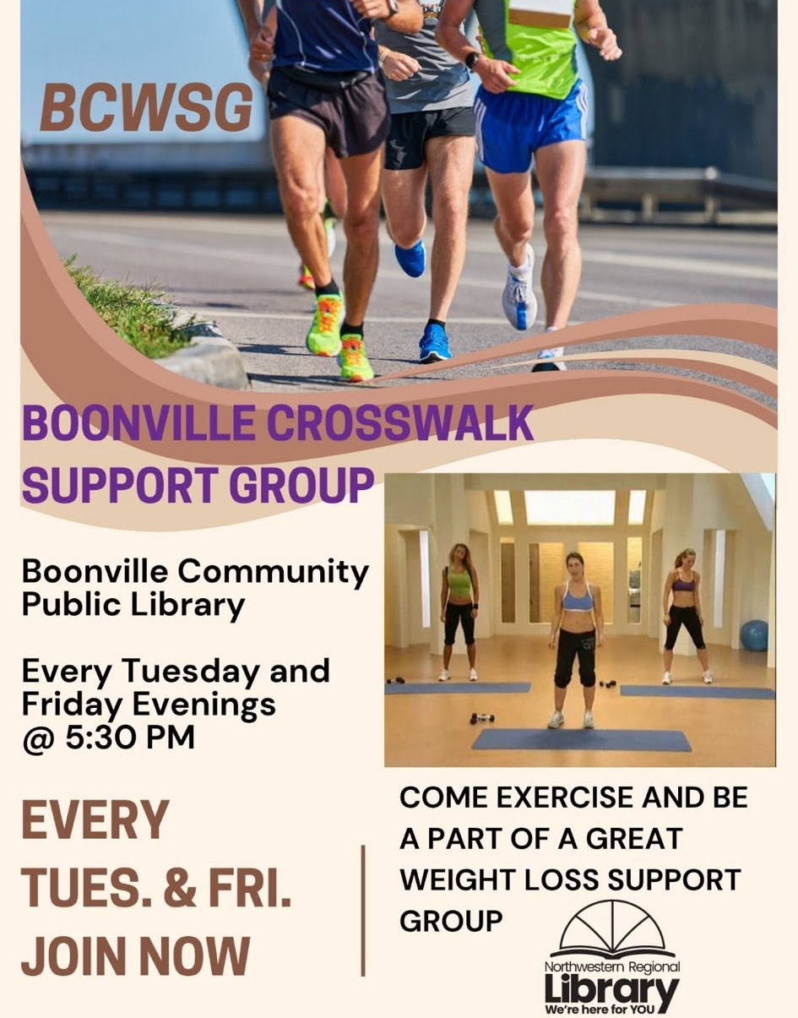
Building Community Partners
Partner Type
Possible Roles
Parks & Recreation
Route access, shared programming, facility use
Health Departments
Promotion, health screenings, speakers
Senior Centers
Participant referrals, event space
Schools
Intergenerational activities, volunteers
Local Businesses
Refreshments, supplies, sponsorship
Media
Publicity, newspaper features, social media
Community Organizations
Co-promotion, joint events
Faith-based institutions
Indoor spaces for walking – especially in rural
Notes:
Emphasize starting with partners you already know. In the Oregon project, the most successful libraries built on existing community relationships. In Florence, the Siuslaw Wind Walkers partnered with the City to create a 10-route walking map. In Coos Bay, the Sole Mates worked with the city manager and both mayors on their walking guide launch. In Stanfield, the Sole Mates partnered with Parks & Rec for Zumba and fitness classes.

Slide 9
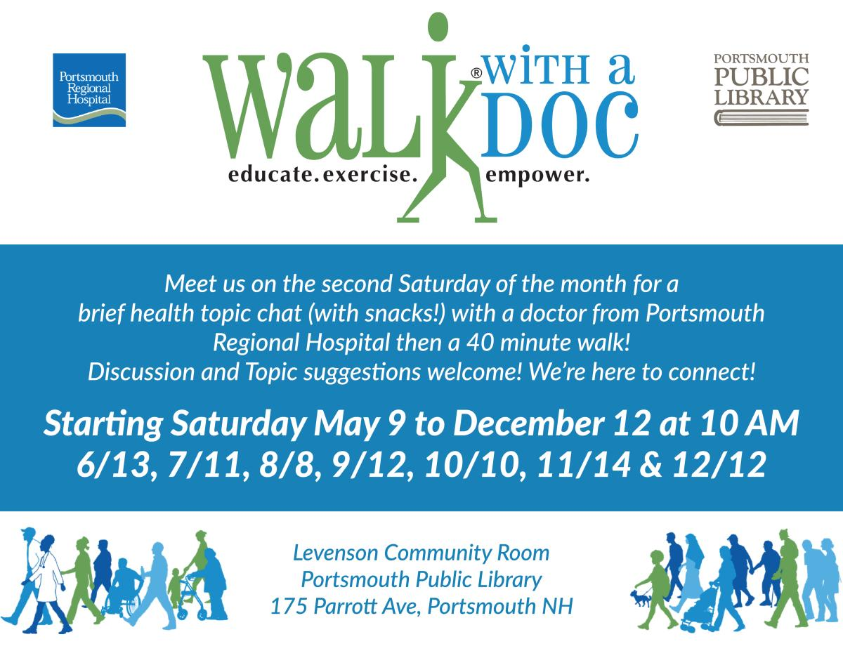
Planning Walking Routes
Map multiple routes at varying distances (0.5 to 2+ miles)
Walk routes yourself before launching the program
Consider safety, accessibility, and scenery
Have weather contingency plans (indoor alternatives)
Rotate routes to keep things interesting [but get it going first!]
Participants enjoy discovering new areas of their community
[Add Photo:
Booklet p.22 — Rural Ramblers
on Banks-Vernonia Trail]
Notes:
Route variety was a key factor in keeping Oregon groups engaged. The Redmond Roamers explored Dry Canyon Trail and surrounding neighborhoods. The Scappoose River Walkers used the paved Crown-Zellerbach Trail, accessible for those with mobility challenges. In Klamath Falls, the Road Scholars walked by the lake in summer and moved indoors to Home Depot in winter! In Nyssa, the High Desert Hoofers walked the Hilltop Memorial Cemetery path and used a church gymnasium for indoor walks.

Slide 10
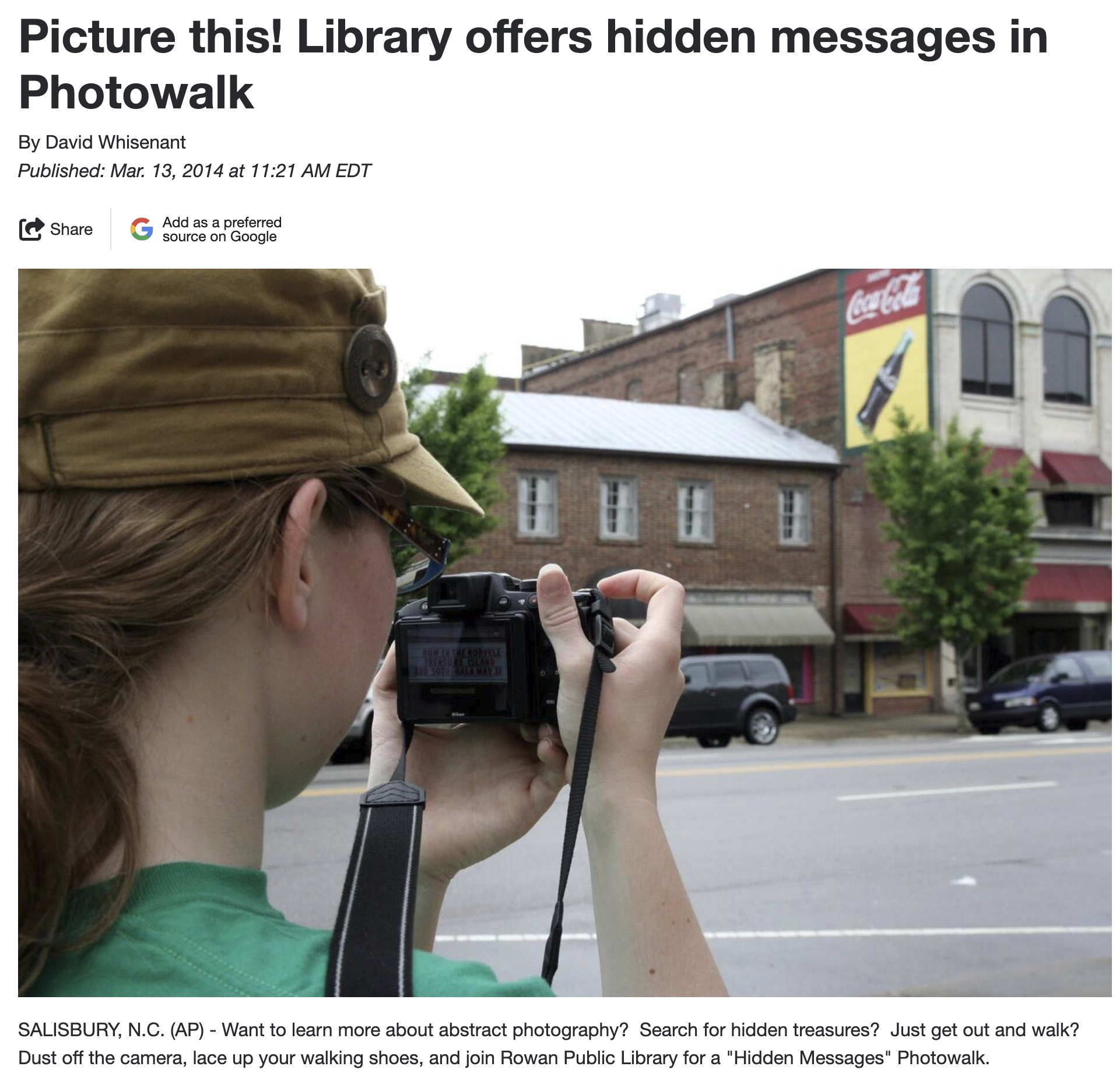
Publicizing and Recruiting Participants
Use library channels: newsletters, social media, website, displays
Ask community partners to help spread the word
Post flyers in community gathering spaces
Word of mouth becomes your strongest recruiting tool
Target adults of all ages and fitness levels
Emphasize the social aspect, not just exercise
Recruitment is ongoing — not a one-time effort
It also takes time! Not an instantaneous effort
Be creative in your hook – not everyone wants to come to a book-centric group
[Add Photo:
Booklet p.23 — Banks
Rural Ramblers group photo]
Notes:
Highlight that recruitment takes time and patience. In Oregon, it took 4-5 months to build a core group at most libraries. The Yachats Road Scholars had a waiting list before the group even started. The Scappoose River Walkers kicked off with 19 members. The Pendleton Walkie Talkies did outreach at the Farmers Market. The social framing was more effective than a fitness pitch.

Slide 11
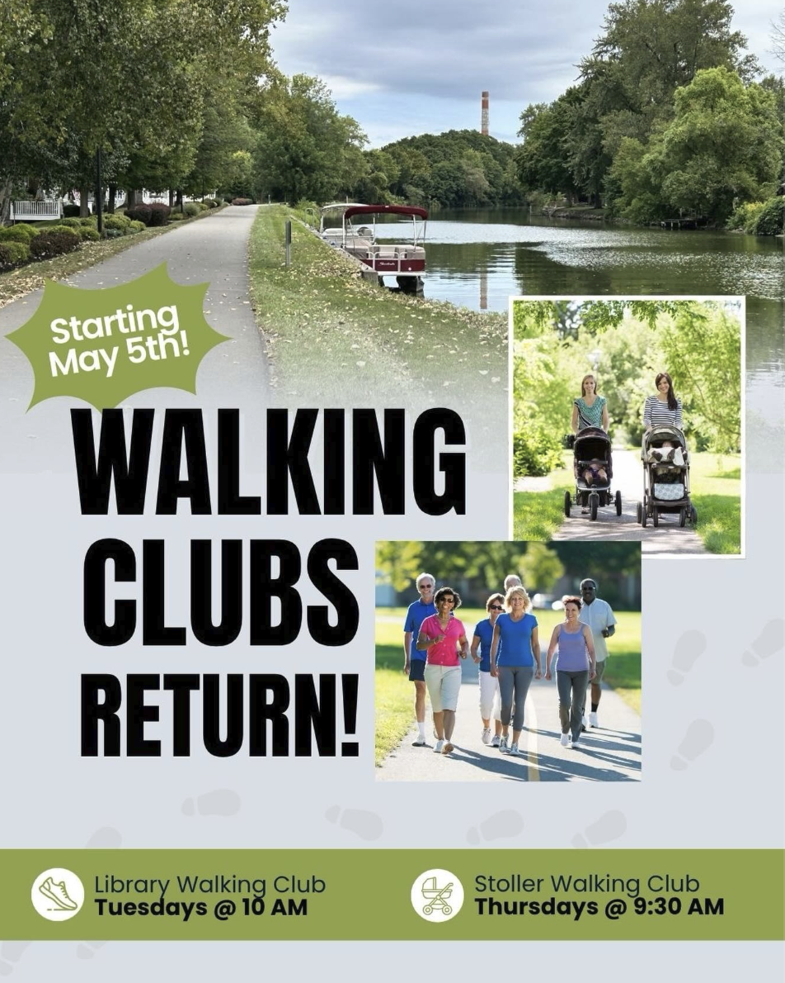
Launching Your Walking Group
Host a kick-off event to build group identity
Provide name tags and welcome kits
Let the group choose their own name
Establish group norms together
Set SMART goals as a group
Create a welcoming, inclusive atmosphere
Oregon group names: Walk On! Gold Beach • Redmond Roamers • Heart & Sole • Shake, Rattle, and Stroll • Siuslaw Wind Walkers • Pendleton Walkie Talkies • Rural Ramblers • High Desert Hoofers • Social Sneakers
Notes:
The kick-off event sets the tone for everything that follows. Group naming creates ownership. Oregon groups chose creative names reflecting their community identity — these names made the group theirs, not the library's. The Stanfield Sole Mates got matching t-shirts. The Wallowa Great Wallowa Walk About walked the Nez Perce Homeland loop, connecting the group to local history.

Slide 12
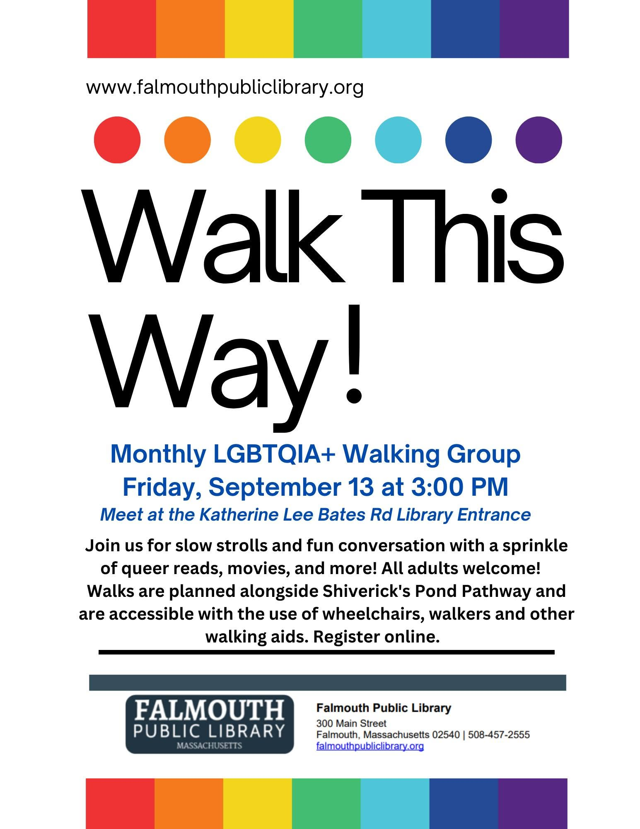
Leading Weekly Walks
Typical 60-Minute Session
10 min: Check-in, warm-up, stretching
30–45 min: Walking (at group pace)
5 min: Cool-down and stretching
Accommodating Different Paces
Use a buddy system for different pace groups
Rule: no one walks alone — fastest walkers loop back
Organize into subgroups by walking speed
Carry a first aid kit and emergency contacts
Notes:
The 10-minute check-in is essential — it builds the social bonds that keep people coming back. The Yachats Road Scholars created three pace groups to accommodate everyone. In Nyssa, the High Desert Hoofers kept the whole group in eyesight at all times — ages 30s to 90s walking together. In Scappoose, the River Walkers organized into smaller subgroups based on walking speed.

Slide 13
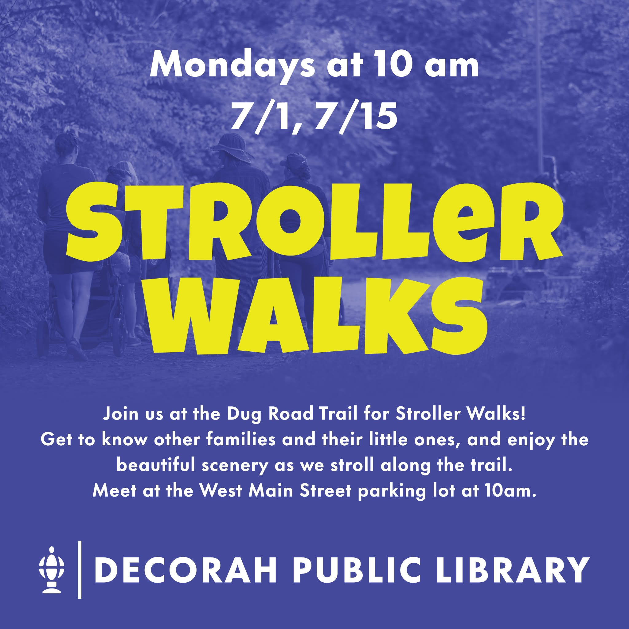
Identifying and Training Peer Leaders
Look for participants who:
Show initiative and enthusiasm
Naturally encourage and support others
Are reliable and consistently attend
Can be trained to lead walks independently
Why peer leaders matter:
Distribute leadership beyond library staff
Build community ownership of the program
Critical for long-term sustainability
Groups can continue even when staff changes
Notes:
Peer leaders often emerge naturally. In Stanfield, the Sole Mates became community builders — three members now serve on the Community Center board. In Banks, one member who joined because she was new to the community is now an active volunteer. At Sweet Home, walking group members became regular library users. Several Oregon groups continued after the study because peer leaders stepped up.

Slide 14
Oregon Walking Groups: A Sampler
Group Name
Library
What Made It Special
Siuslaw Wind Walkers
Florence
10-route map with City; 2,000+ brochures
Walk On! Gold Beach
Curry PL
QR-coded walking routes and signage
Pendleton Walkie Talkies
Pendleton PL
Walking map; Farmers Market outreach
Rural Ramblers
Banks PL
Raised $30K for park exercise equipment
Sole Mates
Coos Bay PL
Walking guide; launch with 105 attendees
Heart & Sole
Dallas PL
Pacific Crest Trail challenge with medals
Road Scholars
Yachats PL
Waiting list; three pace groups
High Desert Hoofers
Nyssa PL
Ages 30s–90s; cemetery trail walks
18 libraries total — see the full booklet for all group stories and photos: https://letsmovelibraries.org/wp-content/uploads/2026/01/FINALRural-Libraries-and-Walking-Study-Booklet.pdf
Notes:
This slide highlights a selection of the 18 Oregon groups. Each developed a distinct identity. Note the range: the Yachats Road Scholars had a waiting list before starting, while the Nyssa High Desert Hoofers spanned ages 30s to 90s. The Coos Bay Sole Mates held a walking guide launch party attended by 105 community members, the city manager, and both mayors. In Florence, the Siuslaw Wind Walkers worked with the City to create a 10-route walking map and distributed over 2,000 brochures, with radio ads to promote the routes. You can share the full booklet with attendees for all 18 stories.

Slide 15
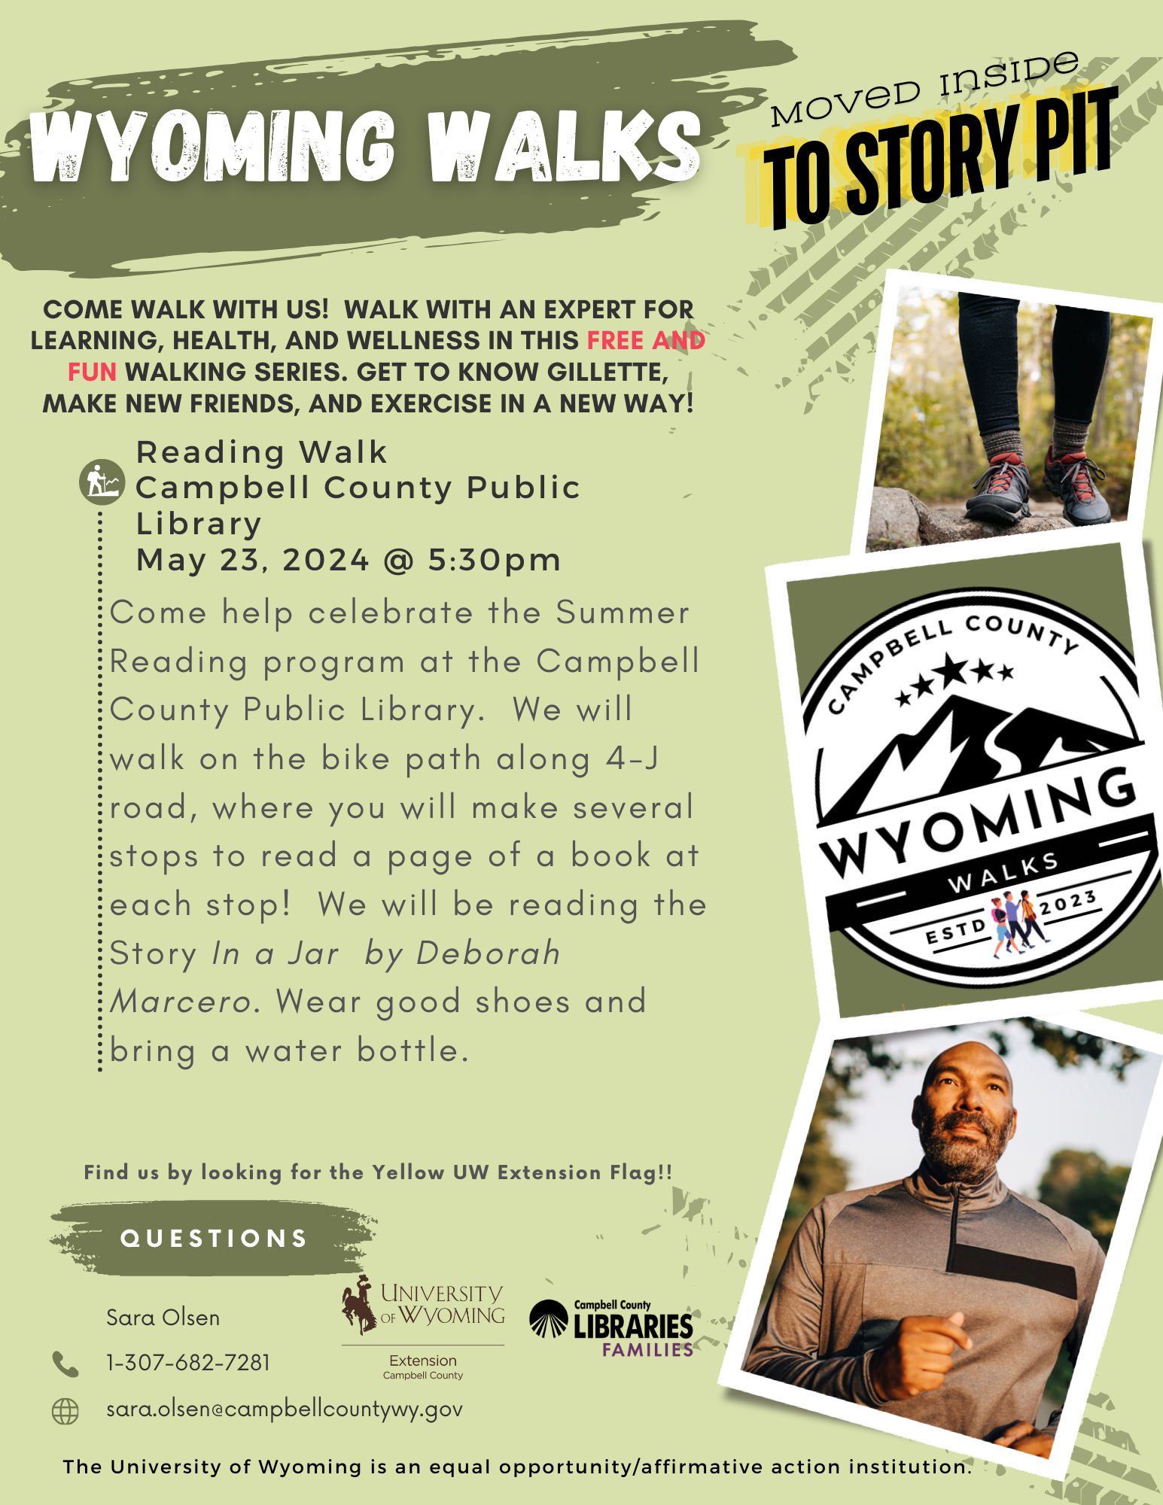
What We Learned
18
2
Rural Oregon
libraries
Years of weekly
walking groups
Key outcomes from participating libraries:
Reduced social isolation among participants
Increased regular physical activity
Stronger community social networks
New community members connected to the library
Participants explored new parts of their communities
Notes:
The social benefits were as significant as the health benefits. Many participants reported the walking group was their primary social outlet. At Sweet Home PL, walking group members became regular library users. In Banks, one member joined because she was new to the community and is now an active volunteer. At Stanfield, three Sole Mates members now serve on the Community Center board.

Slide 16
Participant Voices
“Before this walking group, I never left the house. I was at home, alone for the past 10 years. This walking group gave me a reason to leave the house. I made friends.”
— Walking group participant
“I have lived in [this town] for over 50 years and had never been on some of the trails we walk on. It’s been a great experience exploring our community.”
— Walking group participant
“Walking in this group was the best motivation that I needed to walk every day. When I was home, I would just sit and watch TV, now I want to go out and walk.”
— Walking group participant
Notes:
These are actual quotes from participants in the Oregon walking study. The first quote powerfully captures how the walking group addressed social isolation — someone who hadn't left home in 10 years. The second shows how walking helped long-time residents discover their own community. The third illustrates the motivational power of group walking. Let these quotes sink in — they speak for themselves.

Slide 17

Sustaining Your Walking Group
Peer leaders who take ownership of the group
Consistent schedule and routine (same day, same time)
Low cost to maintain after initial launch
Community partnership support for ongoing promotion
Participant-driven programming and route selection
Social bonds that motivate continued attendance
Celebrating milestones and group achievements
[Add Photo:
Booklet p.11 — Dallas
Heart & Sole with
PCT Challenge medals]
Notes:
Sustainability was built into the model through peer leadership. The Creswell group (Shake, Rattle, and Stroll) planned to continue after the study ended. The Brookings Imagine Change Club was excited to open up to new members and pets. In Scappoose, a new Monday morning group started forming even before the study ended. The Dallas Heart & Sole group did a virtual Pacific Crest Trail Challenge with handmade medals to keep participants motivated.

Slide 18
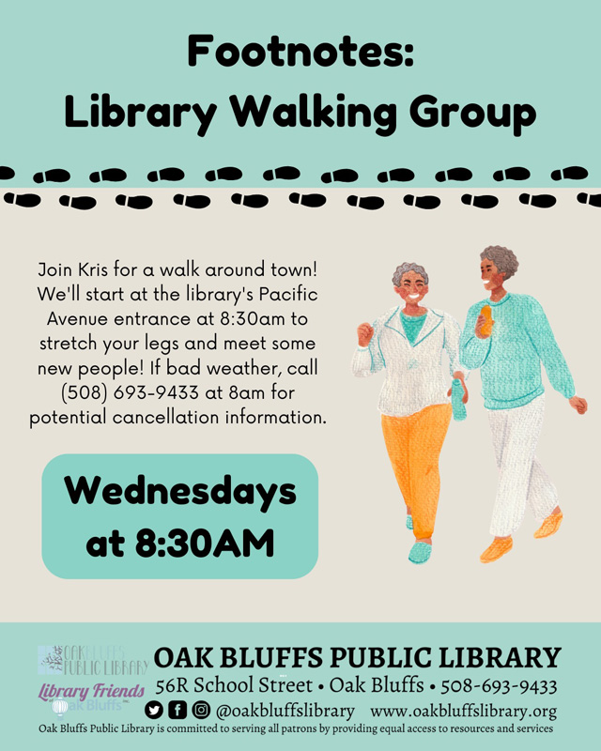
Start Where You Are
You don't need a grant to start a walking group
Begin with staff enthusiasm and community interest
Start small: 3–5 regular walkers is a success
Use existing routes — sidewalks, parks, trails
Build partnerships gradually over time
Adapt the model to your community's needs and setting
Any library can host a walking group
[Add Photo:
Booklet p.12 — Wallowa
Great Wallowa Walk About
on Nez Perce loop]
Notes:
This is the call to action. Emphasize that while the Oregon project was research-funded, the model itself is simple and low-cost. The toolkit provides everything needed to get started. The examples from across the country show that libraries of all sizes, in all settings, are doing this successfully. Encourage attendees to think about who in their community would join a walking group — the answer is usually: more people than you expect.

Slide 19
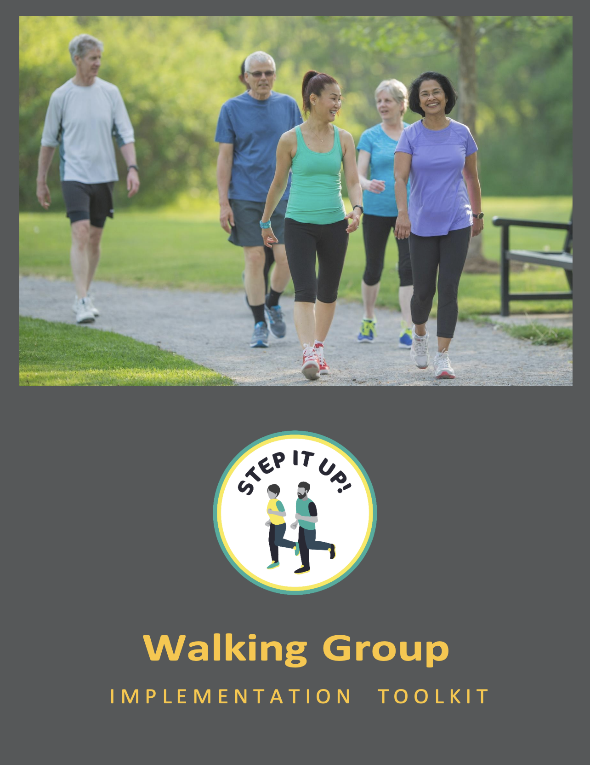
Your Free Toolkit
Step It Up! Program Implementation Toolkit
[Add Image:
Toolkit Cover]
Created by OHSU School of Nursing | Funded by NIH/NINR
The toolkit includes:
10 step-by-step implementation guides
Community partner planning tools
Walking Fundamentals handout
Benefits of Walking handout
Stretching guide with illustrations
SMART goal-setting templates
https://www.ohsu.edu/sites/default/files/2026-02/step-it-up-toolkit-accessible.pdf
Notes:
Direct attendees to the toolkit download page. If possible, have the URL and a QR code on screen. Emphasize that everything they need to get started is in this free resource. Consider having printed copies or cards with the URL available if presenting in person.

Slide 20
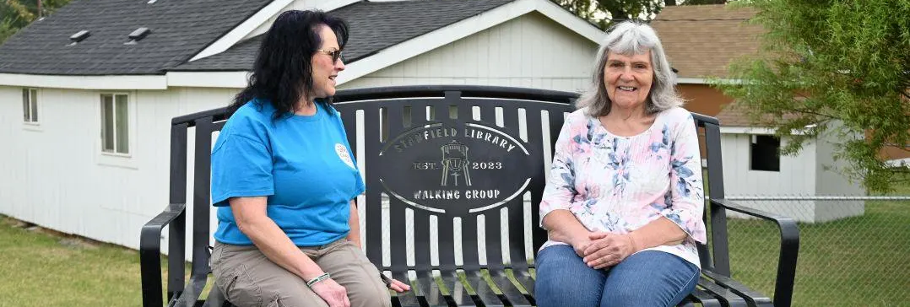

Dream BIG! From groups to infrastructure

Slide 21
Walking + Civic Engagement
Change Club groups used their walks to improve their communities:
Gold Beach
John Day
Walking route brochures
with QR-coded signage
Solar-powered pedestrian
safety signs for city council
Dallas
Banks
Japanese Garden
restoration project
Parcourse equipment in
city park — raised $30,000+
Coos Bay
Brookings
Walking guide to 9 trails
— 500+ copies printed
Improved walking path
and bench in Azalea Park
Walking groups became catalysts for community change
Notes:
Each of these projects came directly from what groups noticed during their walks. In Gold Beach, walkers realized visitors had no guide to local trails, so they created one with QR codes. In John Day, the Walk-a-Lot-te group identified dangerous road crossings and presented solar-powered safety signs to city council. In Banks, the Rural Ramblers raised over $30,000 to install parcourse exercise equipment in Greenville City Park, with a Grand Opening on May 31, 2025. In Coos Bay, the Sole Mates created a walking guide to 9 trails and held a launch party attended by 105 community members including the city manager and mayor.

Slide 22
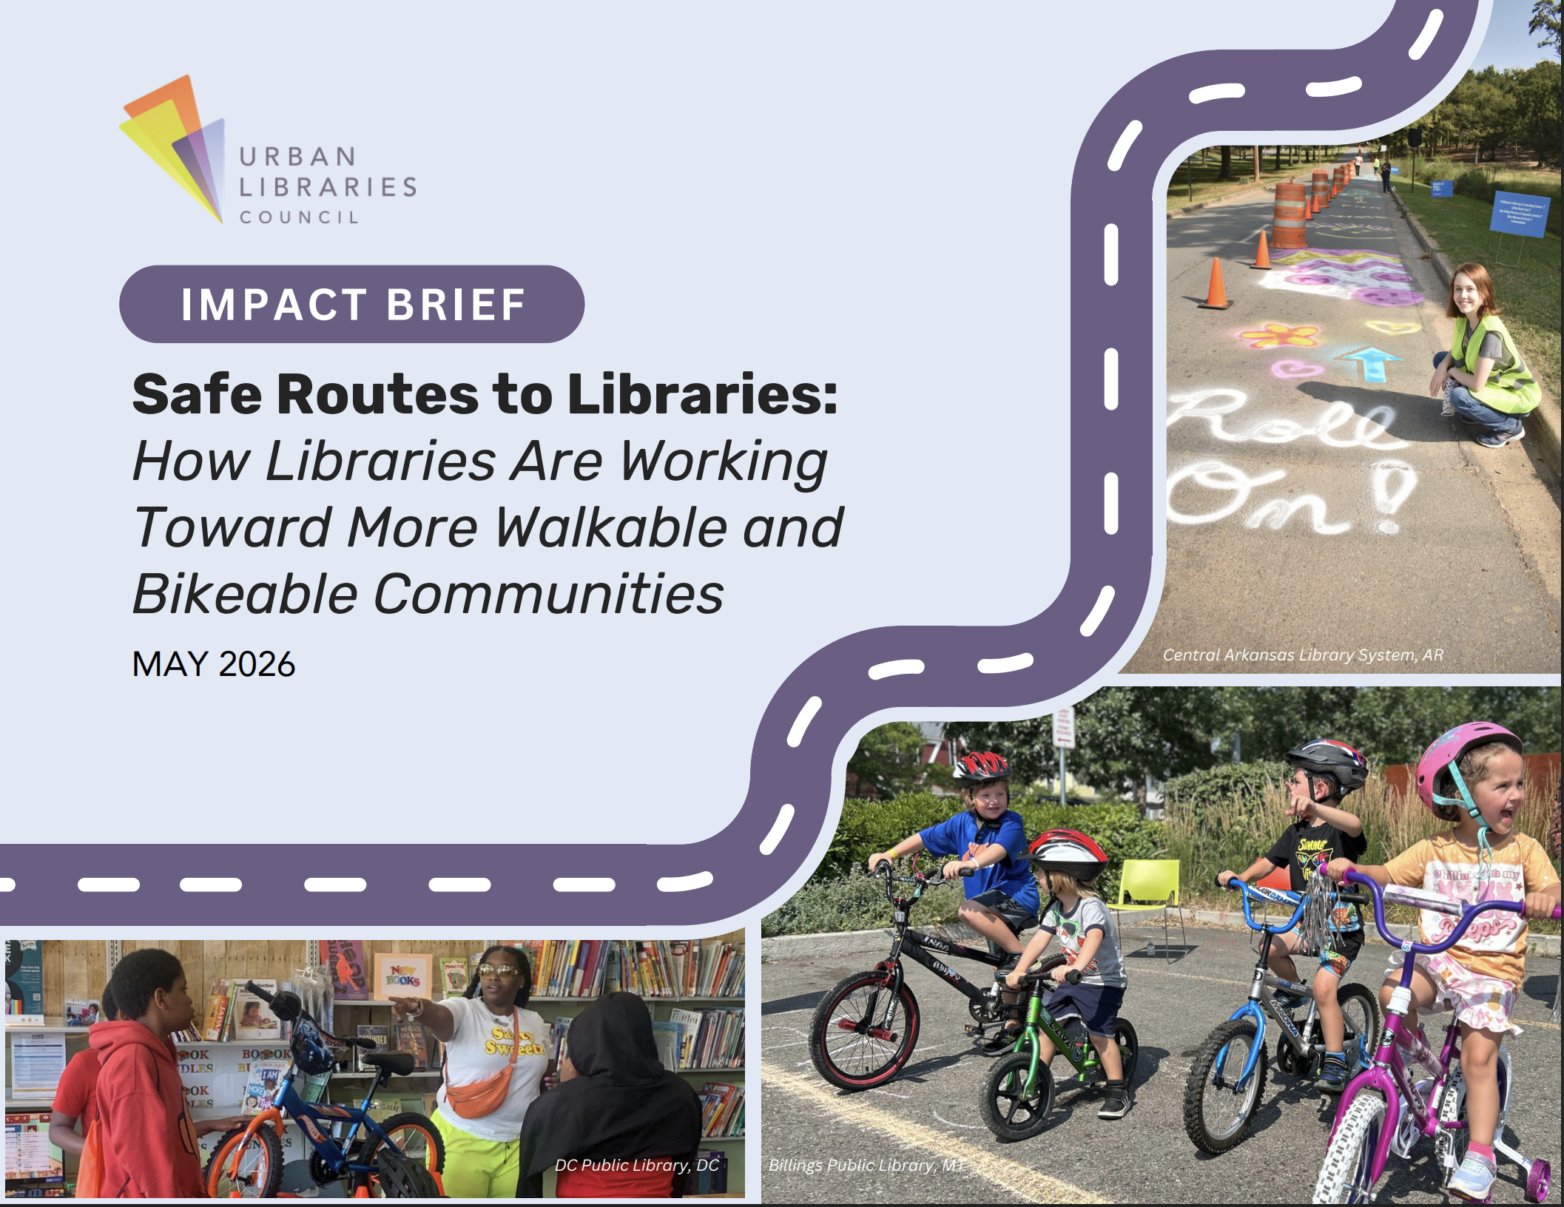
Learn more about safe routes to libraries
https://saferoutespartnership.org/our-work/safe-routes-to-libraries/
https://www.urbanlibraries.org/initiatives/community-health-safety/safe-routes-to-libraries

Slide 23
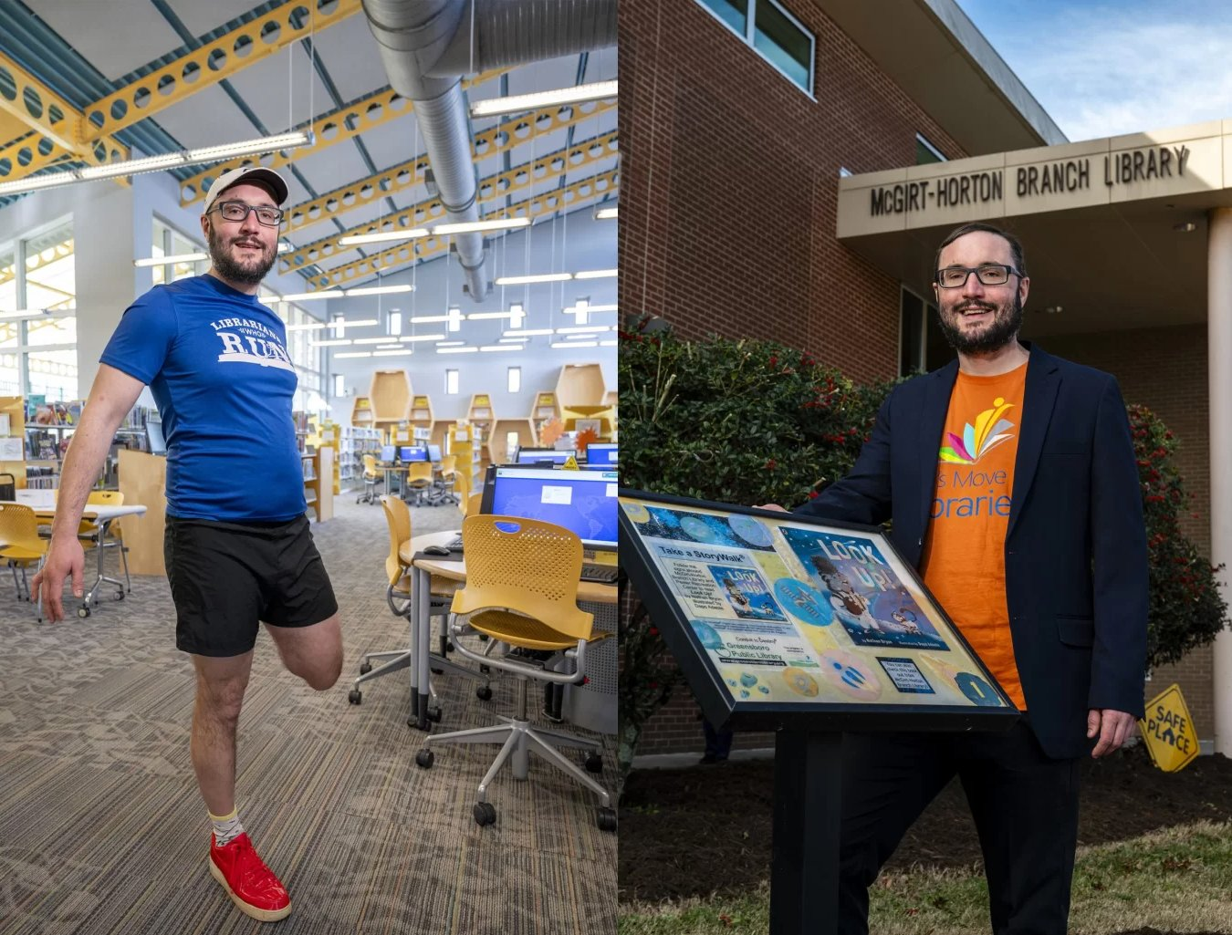
Thank You
Noah Lenstra, PhD, MLIS
University of North Carolina at Greensboro
lenstra@uncg.edu
Subscribe to my newsletter at:
LetsMoveInLibraries.org/about-us/newsletters or just search
Let’s Move in Libraries Newsletter
Funded by NIH / National Institute of Nursing Research
Notes:
Thank the audience. Open the floor for questions. Remind them about the toolkit URL and the walking study booklet. Offer to connect individually for anyone interested in starting a walking group at their library.

