Slide 1
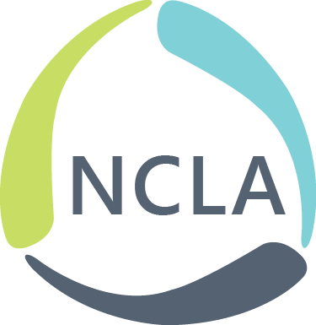
You Are Not Alone: Community Partnerships and Advocacy
LaJuan Pringle
Charlotte Mecklenburg Library
Branch Manager, West Boulevard
NCLA, Library Advocacy and Legislative Section

Slide 2
You Are Not Alone: Community Partnerships and Advocacy
This session will examine community partnerships as a form of advocacy.
Define advocacy and partnerships
Discuss why partnerships are important
Group exercise

Slide 3
You Are Not Alone: Community Partnerships and Advocacy
What comes to mind when you “hear” the term advocacy campaign?
Summer Reading or Break programs
National Library Week
Banned Books Week
PLA Partnerships and Advocacy Committee

Slide 4
You Are Not Alone: Community Partnerships and Advocacy
What does advocacy mean to you?
Advocacy – “an ongoing process of building partnerships so that others will act for and with you, turning passive support into educated action for the library program“ - American Association of School Librarian's (AASL)

Slide 5
You Are Not Alone: Community Partnerships and Advocacy
What does partnership mean to you?
Partnership – “a collaboration that results in an exchange of services, use of facilities, a newly-created service or event, or other transactions between the Library and another entity.” (Wichita Public Library definition)

Slide 6
You Are Not Alone: Community Partnerships and Advocacy
What does advocacy mean to you?
Advocacy – “an ongoing process of building partnerships so that others will act for and with you, turning passive support into educated action for the library program“ American Association of School Librarians (AASL)

Slide 7
You Are Not Alone: Community Partnerships and Advocacy
Why are partnerships important for advocacy?
You’ve identified causes that have community-wide implications.
You’ve identified goals that can be better pursued with expanded networks and resources.
Shared goals can result in laws, legislation or policy changes.

Slide 8
You Are Not Alone: Community Partnerships and Advocacy
Why are partnerships important for advocacy?
You’ve identified causes that have community-wide implications.
What are some causes that are of importance to your communities right now?
How might a partnership or coalition help address these issues?
Who might a library partner with to address some of these issues?

Slide 9
You Are Not Alone: Community Partnerships and Advocacy
Why are partnerships important for advocacy?
You’ve identified goals that can be better pursued with expanded networks and resources.
How has your library expanded networks and resources to offer services?

Slide 10
You Are Not Alone: Community Partnerships and Advocacy
Why are partnerships important for advocacy?
These shared goals can result in laws, legislation or policy changes.
Any initiatives in your libraries that have resulted in policy changes?

Slide 11
You Are Not Alone: Community Partnerships and Advocacy
Group exercise!
Brainstorm some causes that are of importance to your community right now. (Group of 3-4)
Identify potential partners in your communities.
Complete the workshop reflection and the program planning sheet.

Slide 12
You Are Not Alone: Community Partnerships and Advocacy
Resources:
AASLAdvocacyToolkit_180209, American Association of School Libraries - A Division of the American Library Association.” , Feb. 2018, https://www.ala.org/aasl/.
“Wichita Public Library.” Library Partnerships, https://www.wichitalibrary.org/library-partnerships#:~:text=A%20partnership%20is%20defined%20as,the%20Library%20and%20another%20entity.

Slide 13
Examples
Charlotte Mecklenburg Library & Novant Health
Richland Public Library (Social Workers)
Community IDs at Wake County Public Library
Banned Books Week (October 1 - 7, 2023)

